Slide 1
TBANLT 560 Data Mining
Dr Sergio Davalos

Slide 2
Data Mining
Process vs Methodology
Process – steps
Methodology – an approach takes into account steps
Data mining process – steps
Data mining methodology – how its done

Slide 3
Data mining process
Data collection
Clean data
Learn the data
Prepare the data
Identify algorithm - models
Training set, evaluation set, test set
Train model
Evaluate
Performance desired
Deployment

Slide 4
First about the data
Data collection
Issue - Big data
Characterized by four V’s
Velocity – flow rate – speed at which data is generated and changed
Volume – amount of data
Variety – different types of data (currency, dates, numbers, text, etc.
Veracity – data is collected by organic, distributed processes (not from a study)
Big data platforms
Issue – accessing distributed data
Issue

Slide 5
Data collection
Sources
Combine
Format issues
Conversion
Redundancy
Alignment

Slide 6
Clean data
Noisy data
Noise
Missing values
Completeness
Accuracy
Precision
Remove or not
“clean” data

Slide 7
Learn the data
Open it up
Use a tool to examine – excel, r, other
Run statistics on it
Get to know the profile
What are the max, min, means, etc.
What is the distribution?

Slide 8
Prepare the data
Change scale
Standardize – min max
Z
Change distribution profile
All variables same scale
Ordinal vs numeric values
Categorical values – numeric

Slide 9
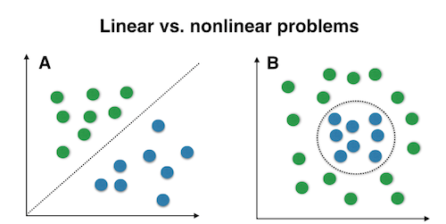
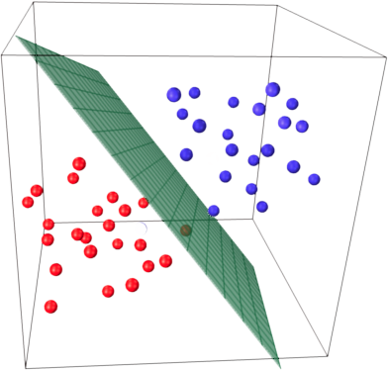
Algorithm – Machine Learning
Supervised
Unsupervised
Task
Prediction
Classification
Estimation
Association
Cluster
Performance issues – size, complexity, number of variables
Dimensionality – variable selection methods

Slide 10
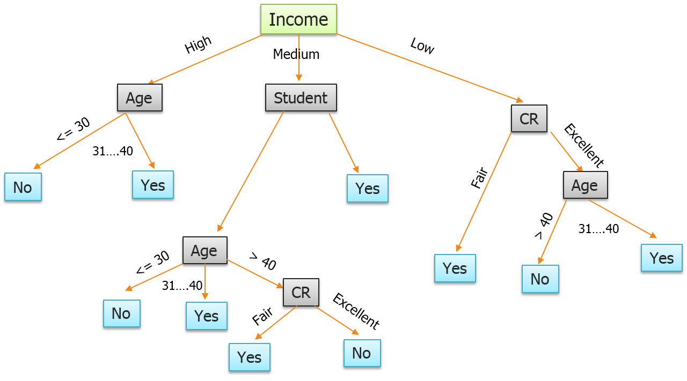
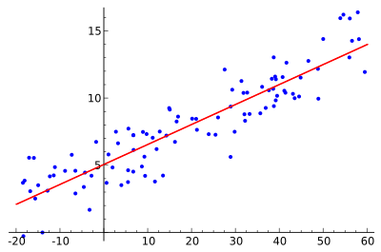
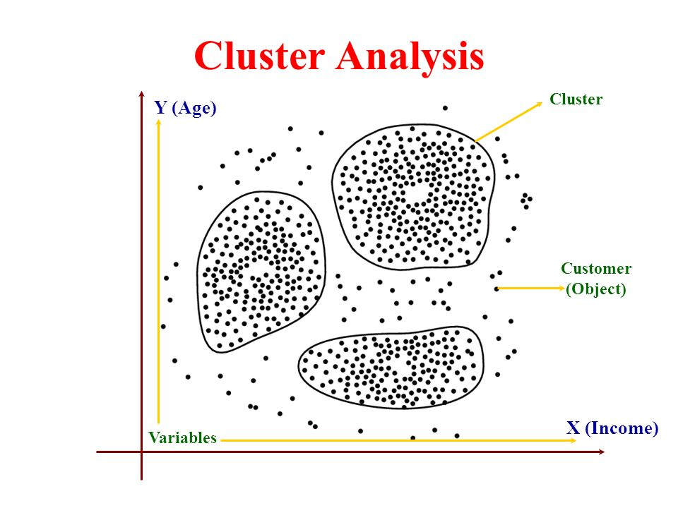
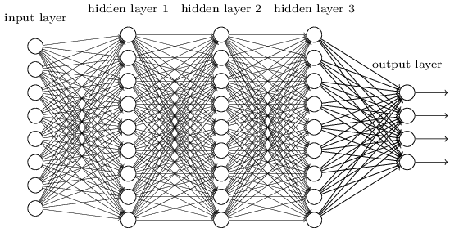
Algorithms
Decision trees
Regression
Cluster
Neural networks

Slide 11
Training and testing
Size of the training set vs the evaluation set
Sampling method
Leave K – out – how to determining K
Bagging – leave k out, replace k several time
Training outcome vs model outcome – matching

Slide 12
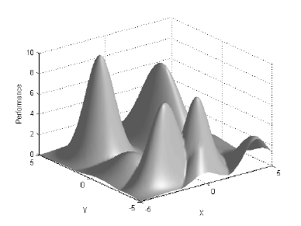
Train the model
Overfitting threat – external validity vs internal validity
Number of variables vs processing time
Reduce dimensionality
Comparison

Slide 13
Evaluation
Measures to use – not all have statistical metrics
Determine target value
Metrics of performance – accuracy, F measure, type I, type II, sensitivity, recall, precision

Slide 14
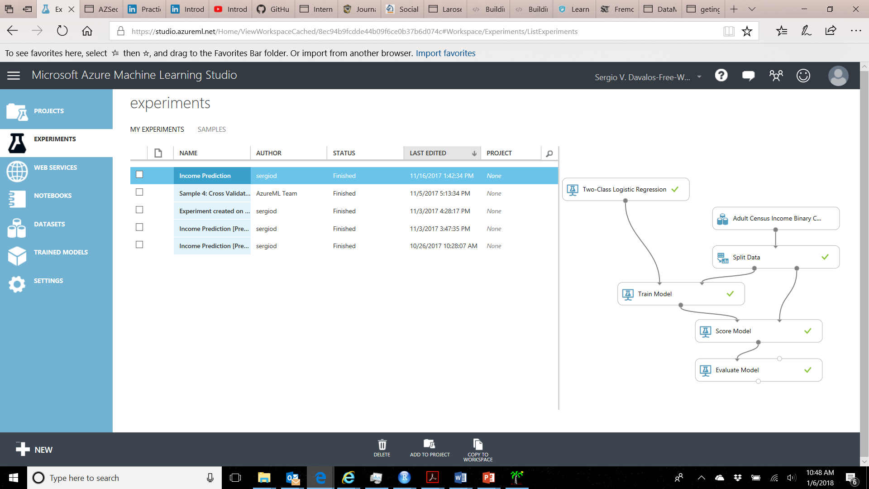
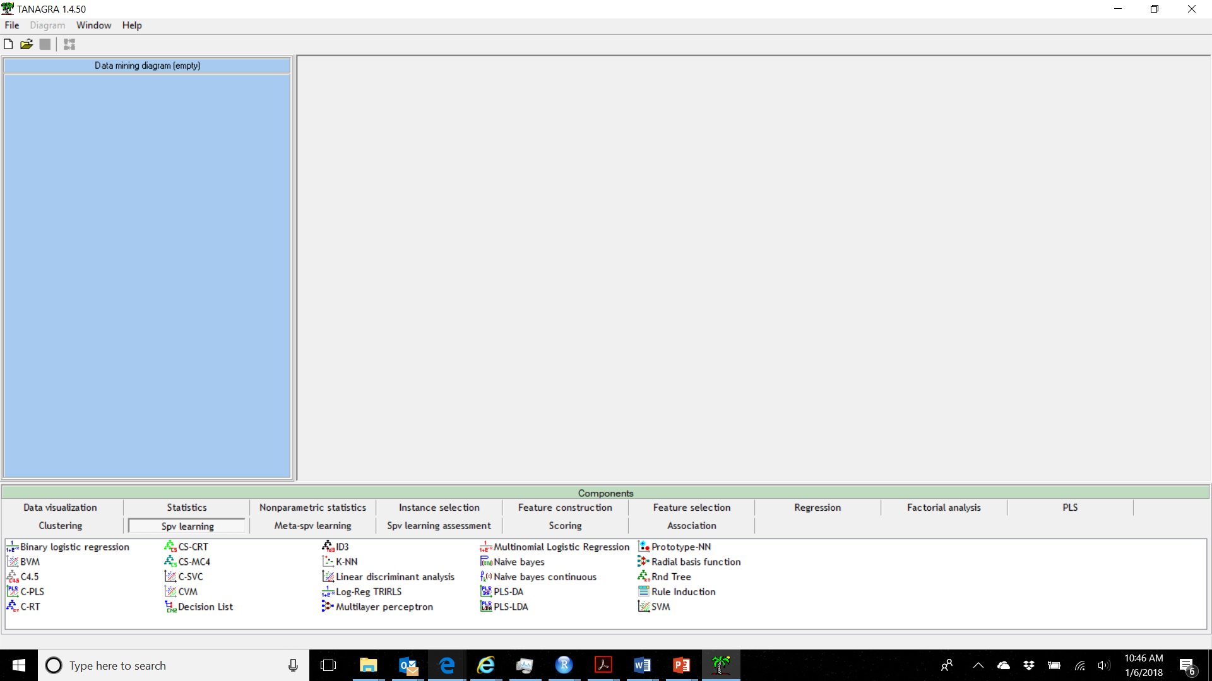
Platforms
R
Python
Azure ML Studio
Weka - Tanagra

